Slide 1

Bank Marketing Algorithm Analysis

Slide 2
Overview
Model Selection
Feature Importance
Take-aways

Slide 3
Model Selection
Examine the classification model that was developed and offer an understanding of the features that have the greatest influence on the model's outcome, both globally and at a specific level.
Model | Accuracy Score
XGBoost Classifier | 0.9102
Kneighbor Classifier | 0.8901
Random Forest Classifier | 0.8782
Decision Tree Classifier | 0.8431
Logistic Regression | 0.8299

Slide 4
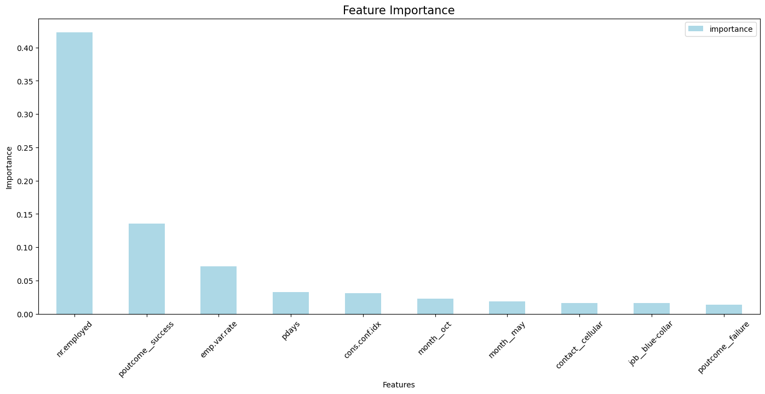
Feature Importance
Number Of Employees
Previous Outcome
Employment Variation Rate

Slide 5
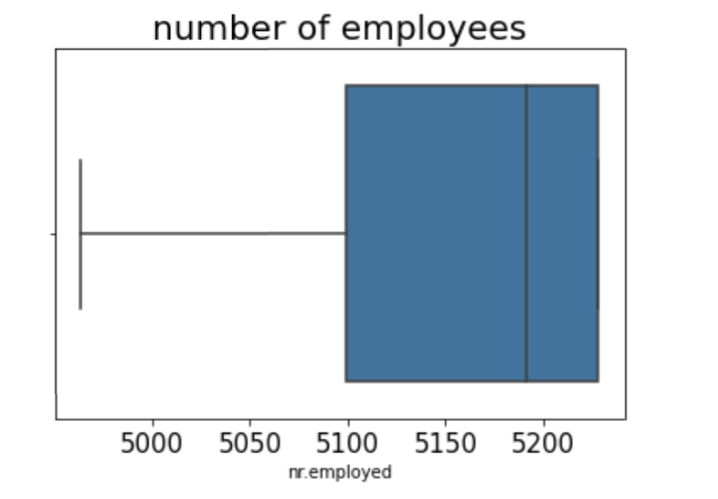
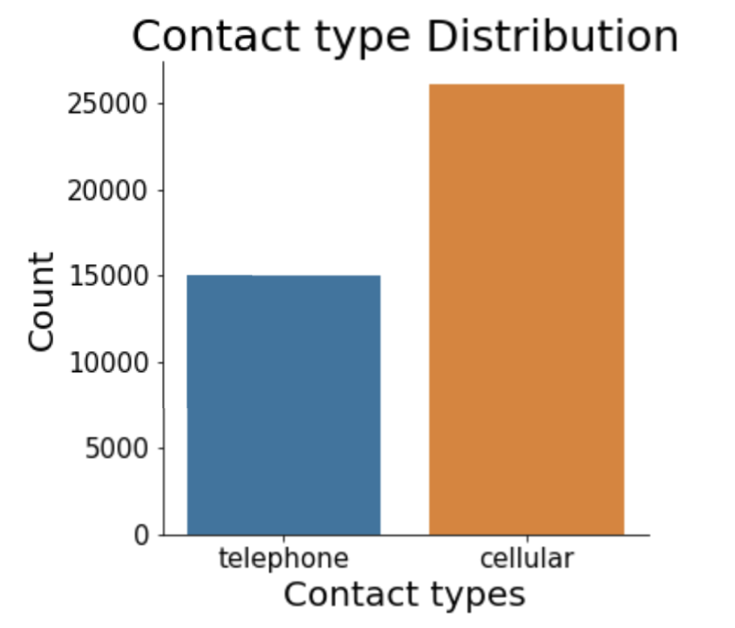
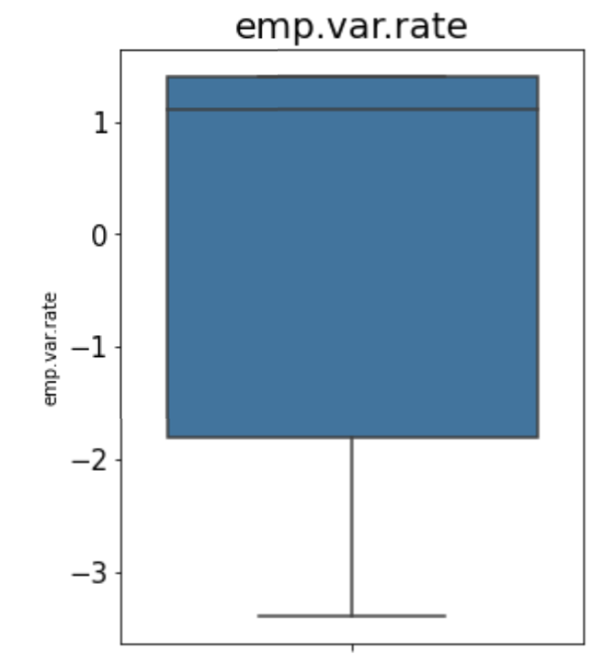
Take-aways
Having a smaller workforce (<5099) has a beneficial effect on the model, but the average number of employees in our dataset is 5167. We suggest that clients opt for cellular communication instead of telephone. A negative rate of change in employment (<-1.8) has a positive impact on our model, whereas the mean rate of change is 0.08.

